Slide 1

Department of Construction Management
Kris Kego
Sem 1 2016/17
CSC 1101

Slide 2

Functional writing is writing that is meant to fulfill real life purposes, such as: making a request or giving advice, inviting someone for a visit or to a function, applying for something.
That is, the writing activities carried out resemble those done in real life for practical purposes
(Creative writing is more for self-expression and pleasure)

Slide 3
This kind of writing practice prepares learners for writing which they must do as part of survival in everyday life
The writing of titles, headlines, advertisements and posters is also a form of functional writing, because people write headlines as a job, and write advertisements and posters to accomplish specific purposes.

Slide 4

These are also called official or business letters and they fulfil official functions, such as applying for a job, apologising to the headmaster, asking for permission to be away, applying for a place as a pupil, etc.
Note the following characteristics of formal letters.

Slide 5

The address of the writer is on the right hand-top-corner.
The date of writing is one line below the writer's address.
On the left-hand side, beginning on the line below the date is found on at least three lines:
  a) The position (title) of the person to whom the letter is written (e.g. manager, president, headteacher) followed by their name.
  b) The place where he/she is working.
  c) The addressee's address.

Slide 6
The way addressees is greeted (addressed), called the salutation, is written two lines below the address, below the addressee's address, e.g.
  ■ "Dear Sir,
  ■ "Dear Madam,"
  ■ "Dear Mr …. ,"
  ■ "Dear Mrs ….."

Slide 7
The subject of the letter is written two lines below the salutation, following RE: which is in the left margin.
The subject is written in capital letters and is underlined. It summarises the purposes of the letter
The main body of the letter follows. Notice how it is begun, the details of information given and the language of the letter.
The complimentary close is a polite, formal expression that is written before the writer's signature: e.g. Sincerely.

Slide 8
The information contained in the main body of the letter depends on the purpose of the letter
"Yours faithfully," is the only one way of ending official letters when you have addressed the person as "Dear Sir“
When you have used the person's name e.g. "Dear Mr. Owiny", you end "Yours sincerely“
Other ways of ending official letters include "Yours truly,“ "Yours in service," etc.

Slide 9

Curriculum Vitae: an outline of a person's educational and professional history, usually prepared for job applications
A CV is the most flexible and convenient way to make applications
It conveys your personal details in the way that presents you in the best possible light
A CV is a marketing document in which you are marketing something: yourself! You need to "sell" your skills, abilities, qualifications and experience to employers

Slide 10

When an employer asks for applications to be received in this format
When an employer simply states "apply to ..." without specifying the format
When making speculative applications (when writing to an employer who has not advertised a vacancy but who you hope may have one)

Slide 11

45% | Previous related work experience
35% | Qualifications & skills
25% | Easy to read
16% | Accomplishments
14% | Spelling & grammar
9% | Education (these were not just graduate recruiters or this score would be much higher!)
9% | Intangibles: individuality/desire to succeed
3% | Clear objective
2% | Keywords added
1% | Contact information
1% | Personal experiences
1% | Computer skills

Slide 12

Personal details
  Normally these would be your name, address, date of birth, telephone number and email
Education and qualifications
  Your degree subject and university, plus A levels and GCSEs or equivalents
  Mention grades unless poor!

Slide 13
Work experience
  Use action words such as developed, planned and organised.
  Try to relate the skills to the job. A finance job will involve numeracy, analytical and problem solving skills so focus on these whereas for a marketing role you would place a bit more emphasis on persuading and negotiating skills

Slide 14
Interests and achievements
  Keep this section short and to the point
  Show a range of interests to avoid coming across as narrow
  Hobbies that are a little out of the ordinary can help you to stand out from the crowd
  Any interests relevant to the job are worth mentioning
  Anything showing evidence of employability skills such as team working, organising, planning, persuading, negotiating

Slide 15
Skills
  The usual ones to mention are languages (good conversational French, basic Spanish), computing (e.g. "good working knowledge of MS Access and Excel, plus basic web page design skills" and driving ("full current clean driving license").
  If you are a mature candidate or have lots of relevant skills to offer, a skills-based CV may work for you

Slide 16
References
  Many employers don’t check references at the application stage so unless the vacancy specifically requests referees it's fine to omit this section completely if you are running short of space or to say "References are available on request."
  Normally two referees are sufficient: one academic (perhaps your tutor or a project supervisor) and one from an employer (perhaps your last part-time or summer job)

Slide 17

It is targeted on the specific job or career area for which you are applying and brings out the relevant skills you have to offer
It is carefully and clearly laid out: logically ordered, easy to read and not cramped
It is informative but concise
It is accurate in content, spelling and grammar. If you mention attention to detail as a skill, make sure your spelling and grammar is perfect!

Slide 18

Spelling and grammar 56% of employers found this
Not tailored to the job 21%
Length not right & poor work history 16%
Poor format and no use of bullets 11%
No accomplishments 9%
Contact & email problems 8%
Objective/profile was too vague 5%
Lying 2%
Having a photo 1%

Slide 19

CVs with spelling mistakes or typos 61%
CVs that copied large amounts of wording from the job posting 41%
CVs with an inappropriate email address 35%
CVs that don’t include a list of skills 30%
CVs that are more than two pages long 22%
CVs printed on decorative paper 20%
CVs that detail more tasks than results for previous positions 16%
CVs that include a photo 13%
CVs that have large blocks of text with little white space 13%

Slide 20

Chronological - outlining your career history in date order, normally beginning with the most recent items (reverse chronological)
This is the "conventional" approach and the easiest to prepare
It is detailed, comprehensive and biographical and usually works well for "traditional" students with a good all-round mixture of education and work experience

Slide 21
Skills-based: highly-focused CVs which relate your skills and abilities to a specific job or career area by highlighting these skills and your major achievements
The factual, chronological details of your education and work history are subordinate

Slide 22
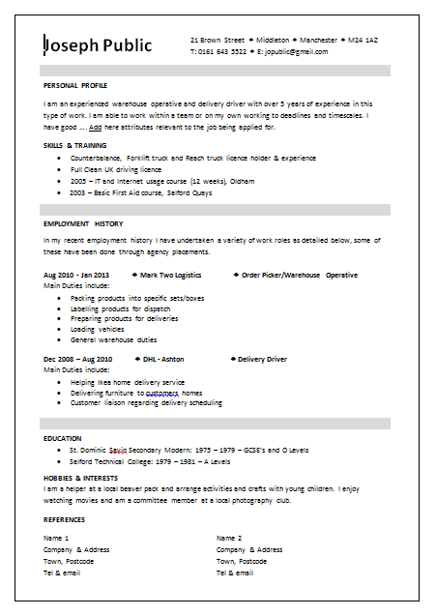

Slide 23

  death_metal_kitty@hotmilk.com
  demented_bovine@gnumail.com
  so_kiss_me@hotmilk.com
  platypus_mcdandruff@gnumail.com
  busty-beth@gnumail.com
  virgin_on_the_ridiculous@hotmilk.com
  original_madcow_jane@gnumail.com
  circle-of-despair@gnumail.com
  sexylikewoaaaah@hotmilk.com

Slide 24

TIMES NEW ROMAN is the standard windows "serif" font. A safe bet - law firms seem to like it but it isn't easy to read on the screen
If you do prefer to use a serif font, try CAMBRIA which has been designed for screen readability
FONT SIZE is normally 12 points for the normal font with larger sizes for subheadings and headings
Most CVs are now read on screen rather than on paper

Slide 25

A memorandum or memo helps members of an organization communicate and share information that is relevant to people within the organization
They allow members or departments within an organization to communicate and relay information
Memos frequently address a small or large group of people, but some of the memos you write may be intended for one person.

Slide 26
Memos should have the following sections and content:
  A 'To' section containing the name of the receiver. ...
  A 'From' section containing the name of the sender. For informal memos, the sender's other name; e.g. ...
  A 'Date' section. ...
  A Subject Heading.
  The message. ...
  Signature.

Slide 27
The text of the memo should be relatively short; one page is a good rule of thumb
While you don’t want to omit any information that the reader needs, it’s also important to keep explanations short and simple

Slide 28

What is the purpose of the memo? What will it tell its recipient(s)?
Why do the recipients need this information?
What are the most important facts that the recipients need to have?
Is there a change that will be occurring? If so, what is the change and when will it occur?
Is there an action that the recipients need to take? If so, exactly what do they need to do? How do they take this action?

Slide 29

www.kent.ac.uk/careers/cv/cvexamples.
Professional Writing. Purdue University College of Liberal Arts. Retrieved November 7, 2014.
Garay, Mary Sue, Bernhardt, Stephen. Expand Literacies: English teaching and the new workplace. Albany: State University of New York Press, 1990. Print. Terk, Natasha (2010). Professional Writing Skills. Write it well.

